Slide 1
Subscribe to DeepL Pro to edit this document.
Visit www.DeepL.com/pro for more information.

Slide 2
Smart contracts on Ethereum

Slide 3
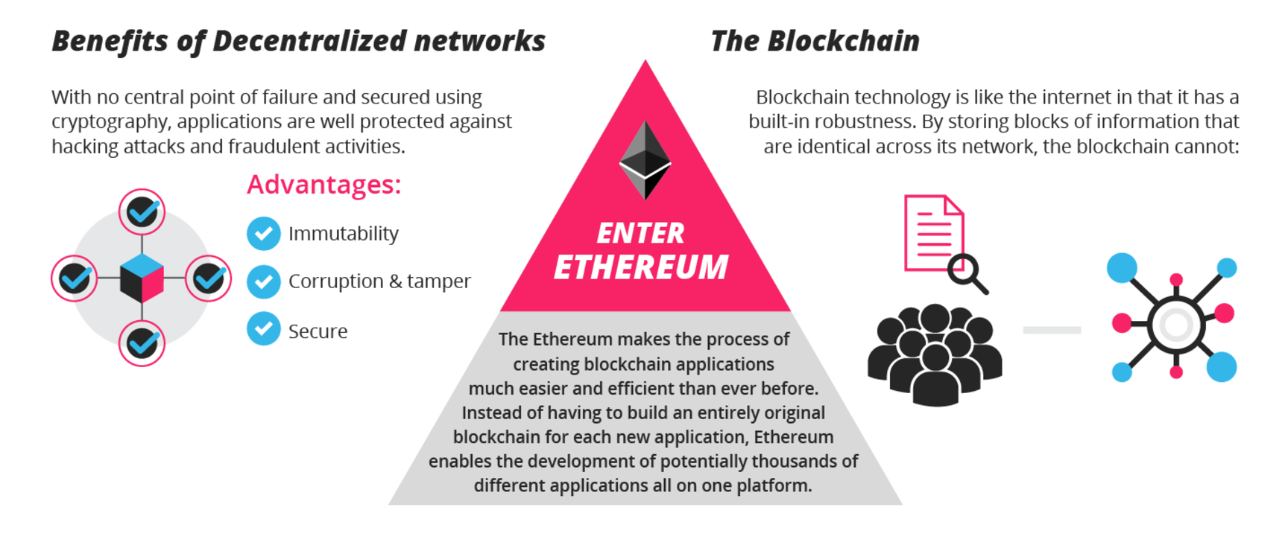
Ethereum Benefits

Slide 4
Smart contracts on Ethereum
Ethereum provides Solidity
A programming language in which to write smart contracts
Transaction-triggered language
Cryptographic identities
Own cryptocurrency (Ether) and thousands of "tokens".
The user pays the cost of execution on the network.

Slide 5
Solidity - Hello World
pragma solidity ^0.4.21;
contract Coin {
// The keyword "public" makes those variables readable from outside.
address public minter;
mapping (address => uint) public balances;
// Events allow light clients to react on changes efficiently.
event Sent(address from, address to, uint amount);
// This is the constructor whose code is run only when the contract is created.
function Coin() public {
minter = msg.sender;
function mint(address receiver, uint amount) public {
if (msg.sender != minter) return;
balances[receiver] += amount;
}
function send(address receiver, uint amount) public {
if (balances[msg.sender] < amount) return;
balances[msg.sender] -= amount;
balances[receiver] += amount;
emit Sent(msg.sender, receiver, amount);
}

Slide 6
Solidity - Listener
Coin.Sent().watch({}, '', function(error, result) {
if (!error) {
console.log("Coin transfer: " + result.args.amount +
" coins were sent from " + result.args.from +
" to " + result.args.to + ".");
console.log("Balances now:\n" +
"Sender: " + Coin.balances.call(result.args.from) +
"Receiver: " + Coin.balances.call(result.args.to));
}
})

Slide 7
Examples of applications
Games of Chance.
Prediction Markets: Gnosis, Augur
Initial Coin Offers (ICOs)
Some examples

Slide 8
Smart Contract Platforms
Blockchain | Smart contracts? | Programming languages
Bitcoin | No
Ethereum | Yes | Solidity
Hyperledger | Yes | GoLang, C++...

Slide 9
Autonomous distributed organizations

Slide 10
Autonomous distributed organizations
A Distributed Autonomous Organization (DAO) is an organization whose rules are established by the code of a smart contract.
Multiple implications:
Autonomous: Independent of the creator
Decentralized: Cannot be turned off
Self-sufficient: Can obtain the resources it needs

Slide 11
Examples
The DAO
Plantoid ( http://www.plantoidproject.eu/ )
Cryptokitties ( https://cryptokytties.co/ )
steemit ( https://steem.it/ )
Autonomous taxis

Slide 12
Connection to the physical world

Slide 13
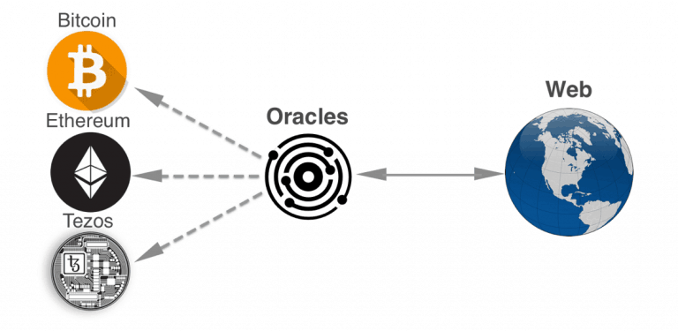
Oracles
Bridge between the real / physical / non-blockchain world and the blockchain system (usually smart contracts).

Slide 14
Oracles
Software
E.g. software that communicates who has won the election.
Hardware
E.g. IoT device that communicates the temperature that it is doing
How can we trust an uncontrolled third party?
Oracle problem in the blockchain

Slide 15
Consensus protocols for oracles
Consensus-based oracles
E.g. Augur is a decentralized prediction market with bets on future events.
They are already being worked on in several networks
E.g. Delphi, Oraclize, Chainlink, Augur

Slide 16
Smart Property
Smart property
Managed through smart contracts
React/query the status of a Blockchain.
E.g. car that works with cryptographic keys.
E.g. http://kointoken.org/

Slide 17
Blockchain + IoT

Slide 18
Advantages and opportunities
Interoperability
Communication between IoT devices in open ecosystem
Security
No reliance on third parties (distributed)
Identity
Asymmetric Key Infrastructure
Immutable record
Transactions and traceability
…

Slide 19
Challenges and drawbacks
Costs
Transaction, execution, storage)
Privacy
Full transparency of transaction history
Scale
Limited transactions per second
Storage Size
Security
Unstoppable software (bugs, undesirable features...)
e.g. The DAO: $50M hack
Ex. Parity (multi-signature wallets): $32M hack, 8x more money saved by white hat hackers
Legality
Ethics
…

Slide 20
Standardization
Trusted IoT Alliance
Partnership for the development of secure IoT ecosystem on blockchain
Hyperledger Project
Open Source Standard for Private Blockchains

Slide 21
IoT Applications
Supply chain tracking
E.g. Chronicled ( https://www.chronicled.org/ ) , OriginTrail ( https://origintrail.io/ )
Identity and authorization
E.g. Uport ( https://www.uport.me/ )
Secure Device to Blockchain connectivity
E.g. Filament ( https://filament.com/technology/ )
Smart Property
Ex. Slock.it ( https://slock.it/ )
Blockchain Infrastructure for IoT
E.g. IoTeX ( https://iotex.io/ ), IOTA ( https://iota.org/ )
Connection with sensors
e.g. Pylon ( https://pylon-network.org/ ) decentralized ecological energy exchange
…

Slide 22
Conclusions

Slide 23
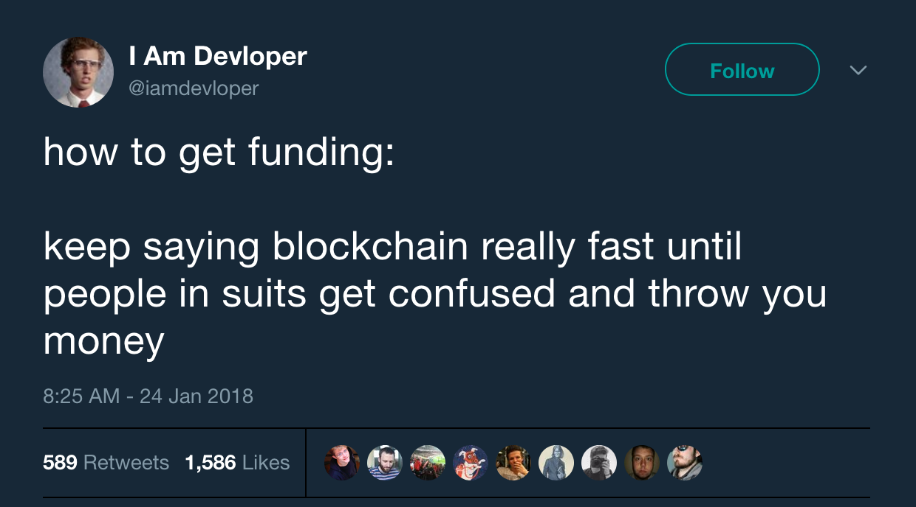
When to use Blockchain?

Slide 24
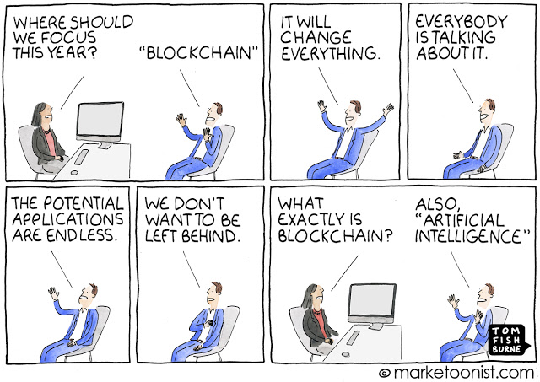
When to use Blockchain?

Slide 25
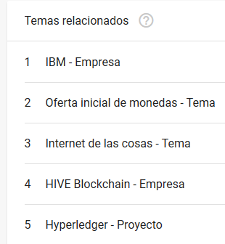
When to use Blockchain?
Google Trends for Blockchain

Slide 26
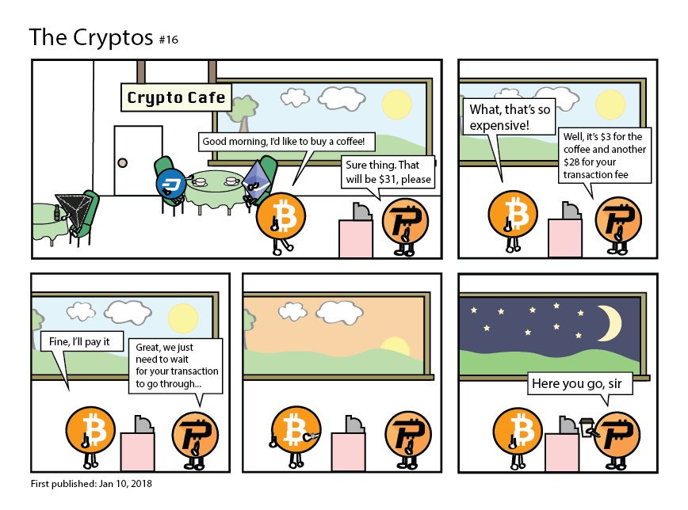
When to use Blockchain?

Slide 27
When to use Blockchain?

Slide 28
When to use Blockchain?
When YES
Digital relationship management and assurance
Maintenance of a shared and decentralized record-keeping system
Any place where an intermediary or gatekeeper is expensive in time or resources
When you need to securely store complex transactions between multiple parties
When there is data in constant flow but you want to keep a history of actions

Slide 29
When to use Blockchain?
When NOT
High throughput in number of transactions per second required
Small organizations
No business networks
BD Substitute
Messaging Solution Substitute
Transaction Processing System Substitute
Some discussion

Slide 30
When to use Blockchain?
Easy, isn't it?
So, when?
Workshop

Slide 31
Questions?

Slide 32
Conclusions
What have we learned?

Slide 33
Questions?

Slide 34
Questions?

Slide 35
References

Slide 36
References
[EdX, 2019] EdX: Introduction to Hyperledger Blockchain Technologies. 2019. Available at https://www.edx.org/course/blockchain-for-business-an-introduction-to-hyperledger-technologies on 1/10/2019
[Ethereum, 2019] Ethereum: Ethereum White Paper. 2019. Available at https://github.com/ethereum/wiki/wiki/White-Paper on 1/10/2019.
[Linux Foundation, 2019] The Linux Foundation: Hyperledger. 2019 Available from https://www.hyperledger.org/ on 1/10/2019.
[Nakamoto, 2008] Nakamoto, S.: Bitcoin - A peer-to-peer electronic cash system. 2008. Available at https://bitcoin.org/bitcoin.pdf on 1/10/2019
[Wood, 2014] Wood, G.: Ethereum - A secure decentralised generalised transaction ledger. Ethereum Project Yellow Paper, 151. 2014. Available at https://ethereum.github.io/yellowpaper/paper.pdf on 1/10/2018
[Filippi & Hassan, 2016] Filippi, P., Hassan, S.: Blockchain technology as a regulatory technology - From code is law to law is code. First Monday, 21(12). Available at http://dx.doi.org/10.5210/fm.v21i12.7113 on 1/10/2019

Slide 37
Glossary

Slide 38
Glossary
DB = Database
BYOE = Bring Your Own Encryption
DAO = Distributed Autonomous Organization
P2P = Peer to Peer
PoS = Proof of Stake
PoW = Proof of Work

Slide 39
Extras

Slide 40
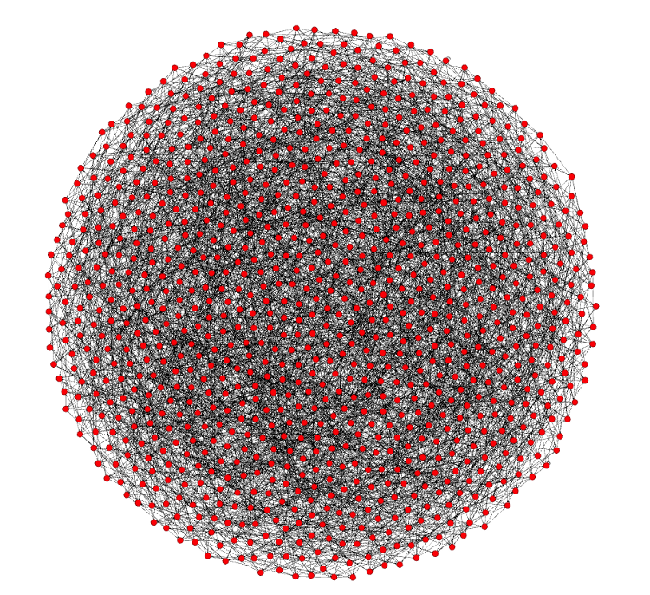
Bitcoin today

Slide 41
Speed of transactions
Notes:
Source unknown

